Slide 1
Introduction to Electric and Electronics
Chapter 6 –
Variable-frequency Network Characteristics

Slide 2
Learning Objectives
Learning Objectives
To understand the concept of sinusoidal frequency network
To learn the basics of passive filter, including LPF, HPF, BPF, and band elimination
To understand the importance of resonance and be able to analyze resonant circuits, both series and parallel.

Slide 3
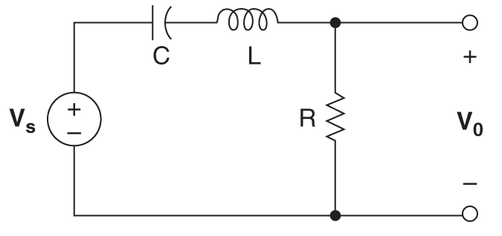
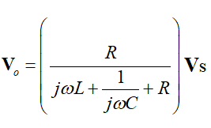
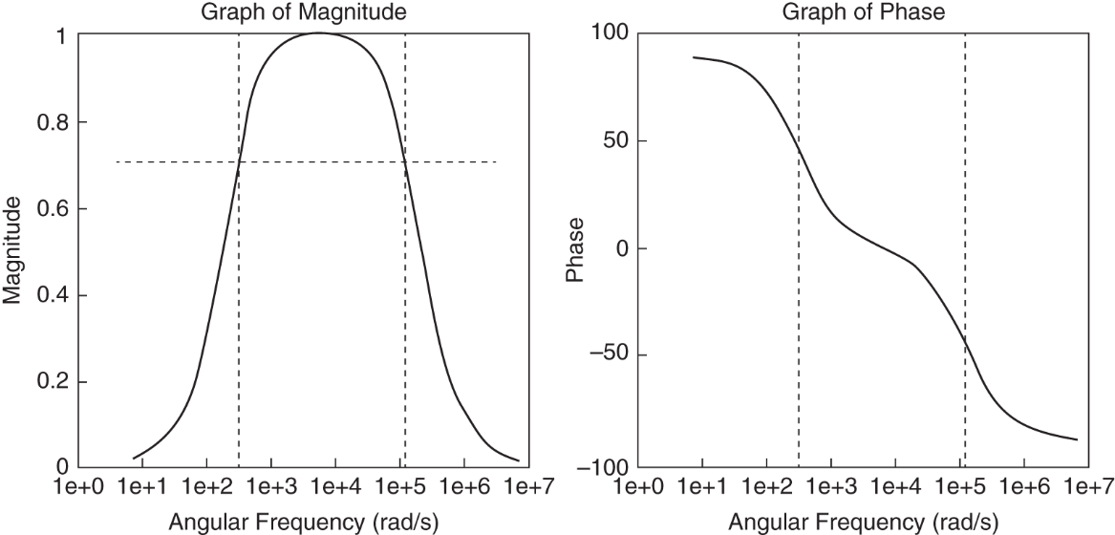
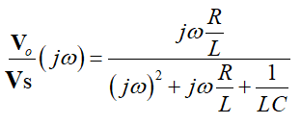
Sinusoidal Frequency Response
Sinusoidal Frequency Response
Frequency response
Output voltage
Frequency transfer function

Slide 4
Sinusoidal Frequency Response
General form of a transfer function
Poles and zeros
the dynamic properties of a system can be gleaned from poles.

Slide 5
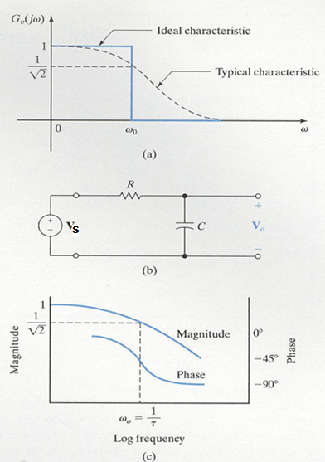

Passive Filter Networks
A simple low-pass network
voltage gain
Frequency transfer function
Half-power(break) frequency

Slide 6
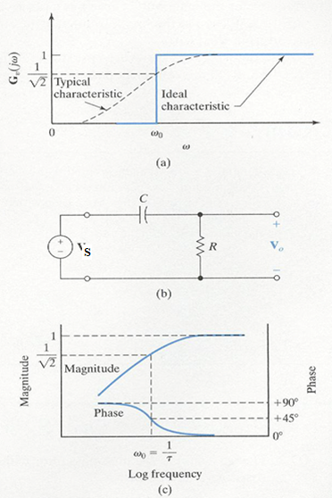
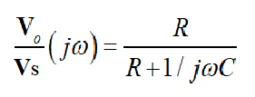
Passive Filter Networks
High-pass filter
voltage gain
Frequency transfer function
Half-power frequency phase

Slide 7
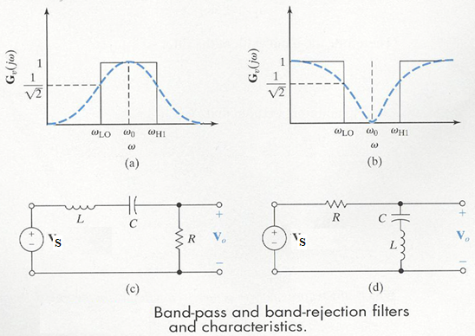
Passive Filter Networks
Band-pass filter, Band-elimination filter
Transfer function
Bandwidth
center frequency

Slide 8
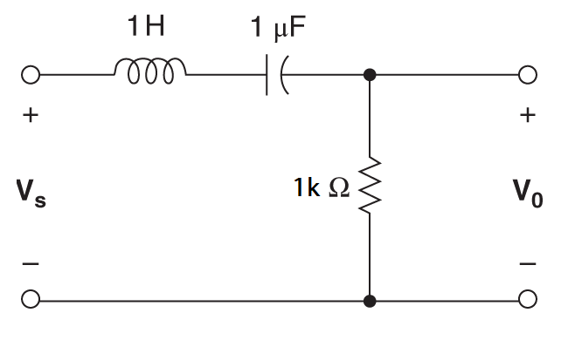
Passive Filter Networks
Example
center freq.
lower freq.
higher freq.
Bandwidth

Slide 9
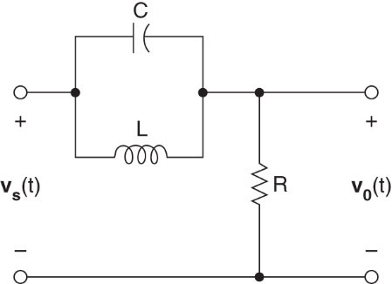


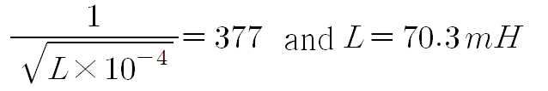
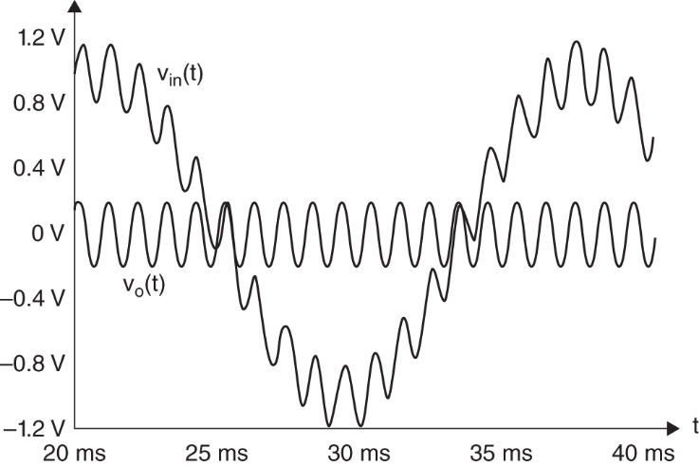
Passive Filter Networks
Example: notch filter
We want a center freq. 60Hz or 377rda/s
If
If input consist of 60Hz and 1000 Hz sinusoidal signal

Slide 10
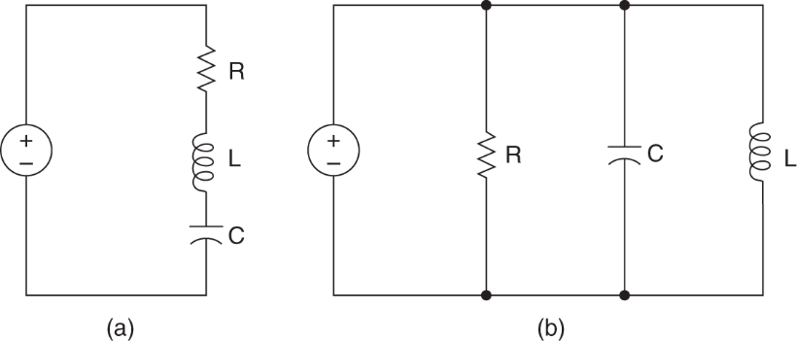
Resonance
Resonance
Impedance for RLC circuit
series
parallel
Zero reactance
at resonant frequency

Slide 11
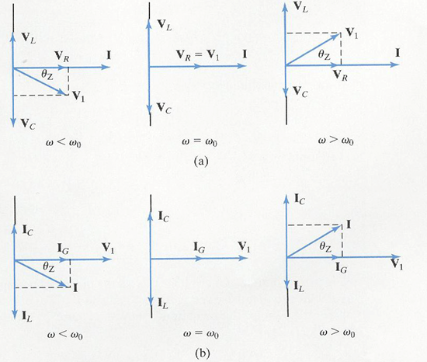
Resonance
Phase diagram

Slide 12
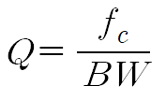
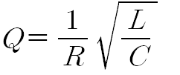
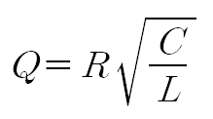
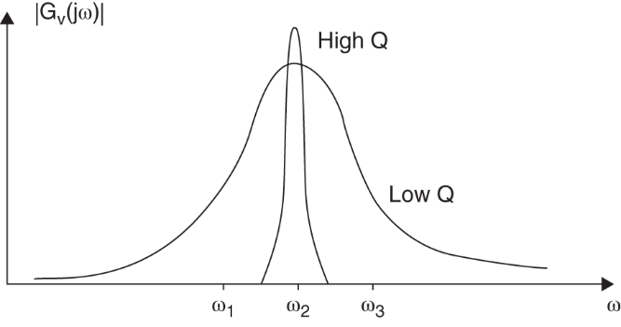
Resonance
Quality factor
for series for parallel

Slide 13
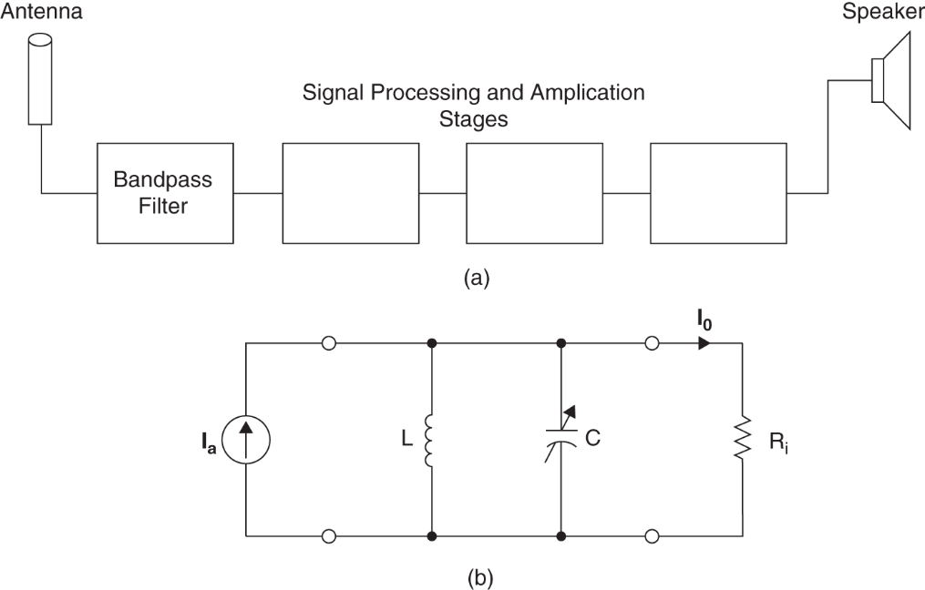
Resonance
Example 6.13 AM

Slide 14
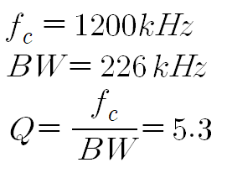
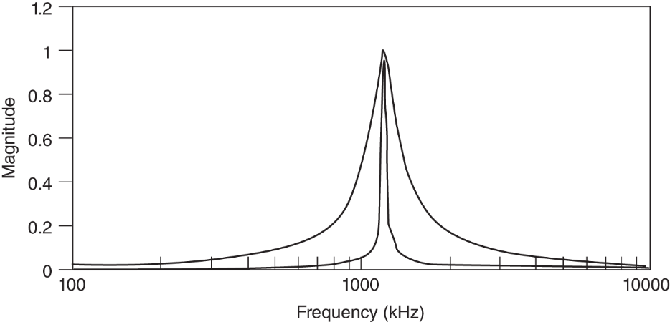
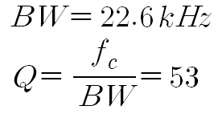
Resonance
Example 6.13 AM(continue)
Here

Slide 15
Homework
Homework
Solve Problem 6.28
Read Text Chapter 9.
Prepare Presentation

